Slide 1
POLAR
CURVES

Slide 2
SPECIFIC OBJECTIVES:
At the end of the lesson, the student is expected to be able to:
• define polar coordinates.
• plot points polar coordinates.
• write and sketch the graphs of polar equations.
• convert polar to rectangular and vice versa.

Slide 3
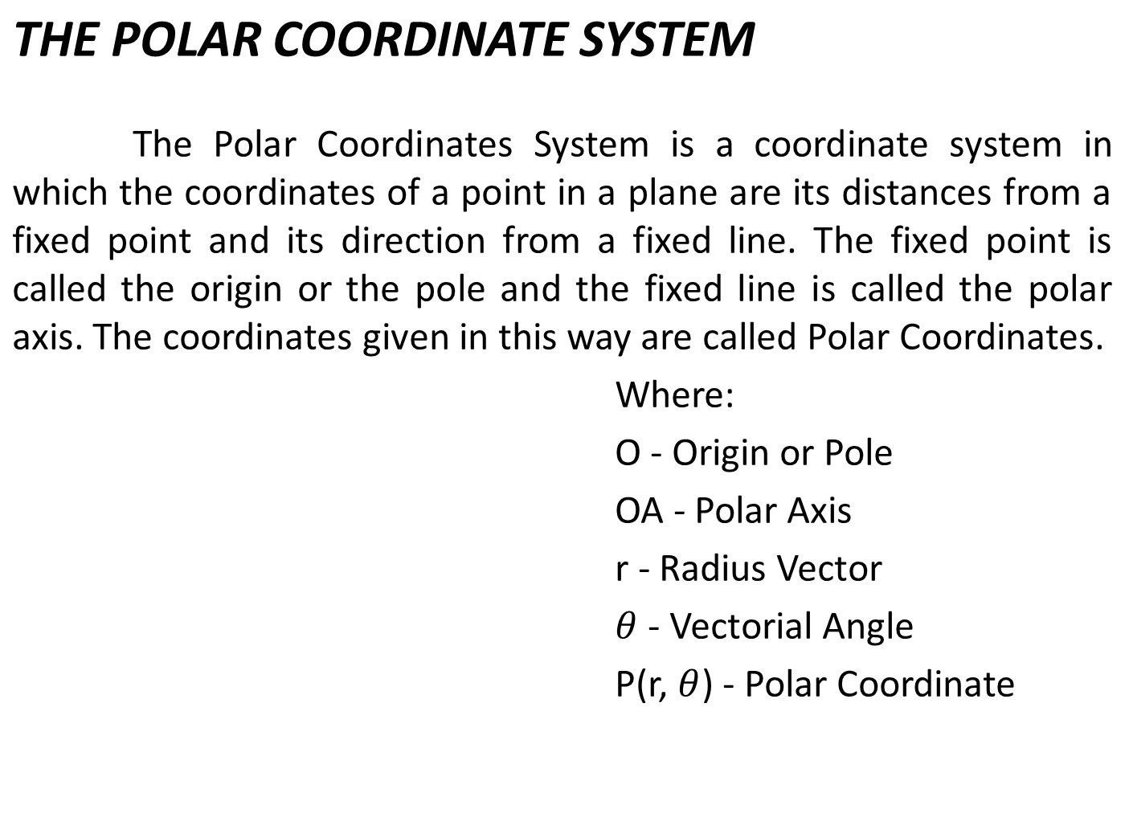
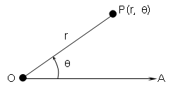

Slide 4
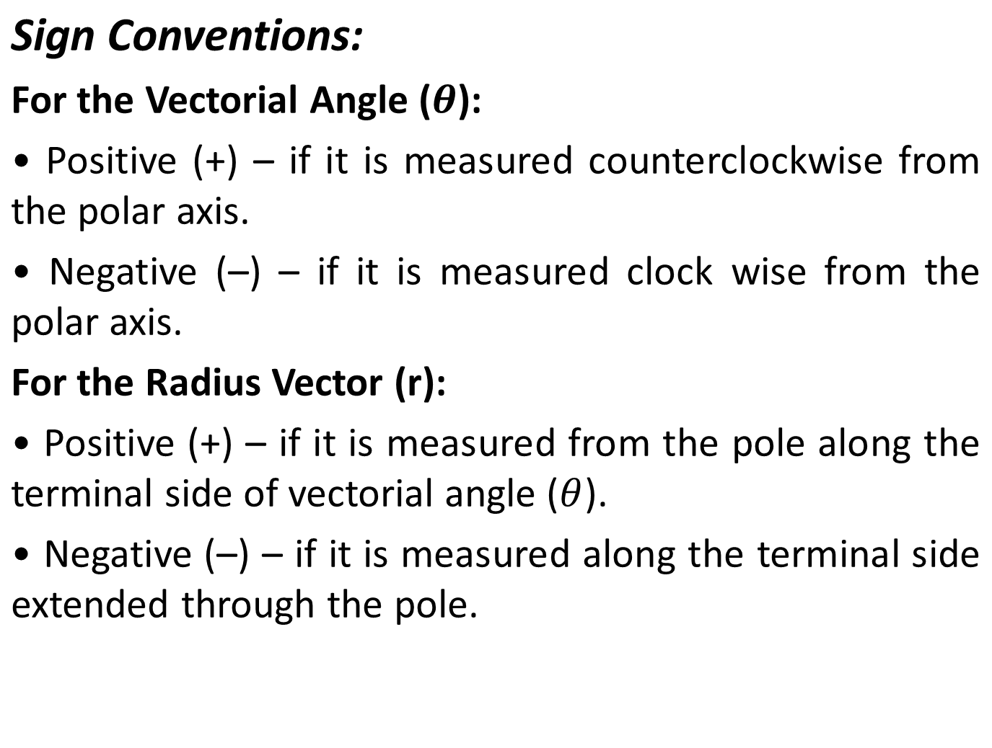

Slide 5
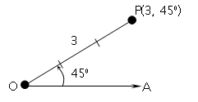
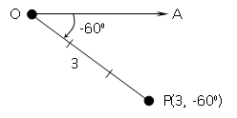
Examples: Plot the given points on a polar coordinate system.
P (3, 45°)
b. P (3, –60°)

Slide 6
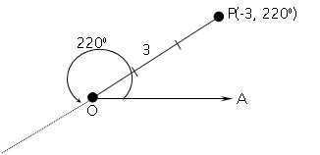
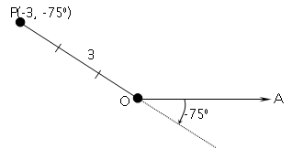
c. P (–3, 220°)
d. P (-3, –75°)

Slide 7


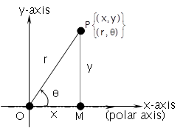
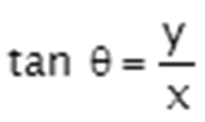
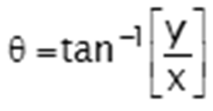
RELATIONS BETWEEN RECTANGULAR AND POLAR COORDINATES
The transformation formulas that express the relationship between rectangular coordinates and polar coordinates of a point are as follows:
and
Also,
;
;

Slide 8
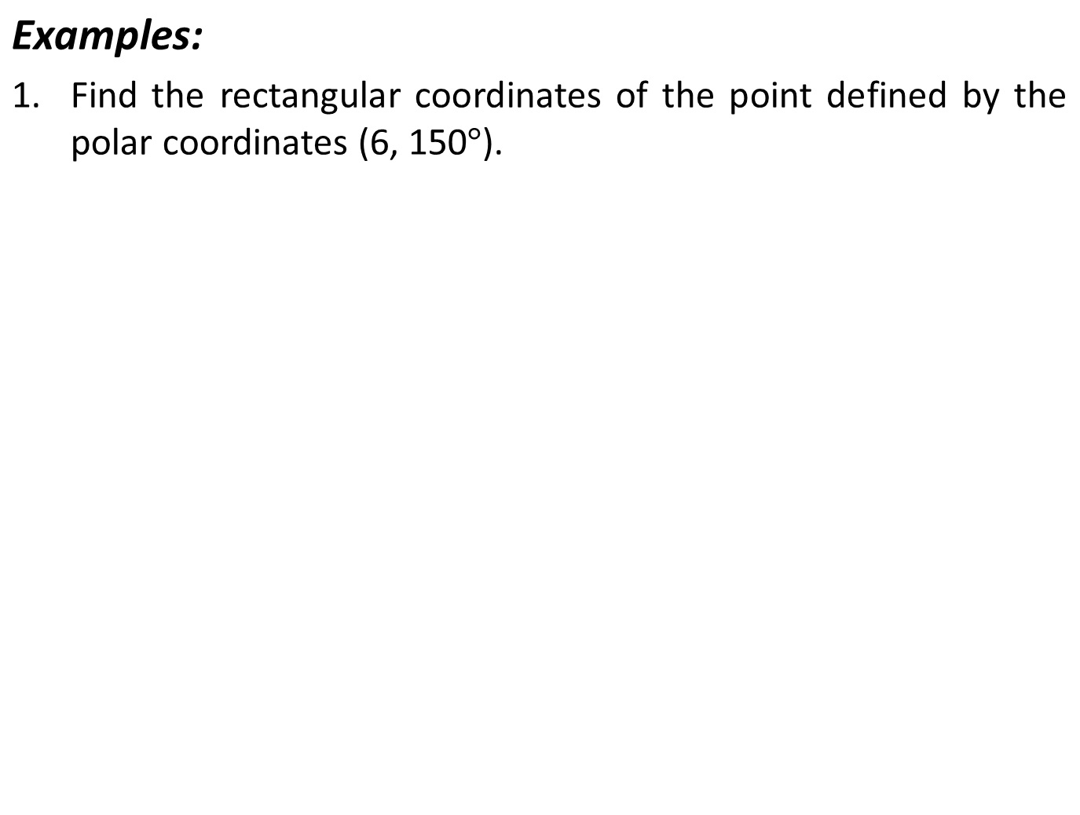
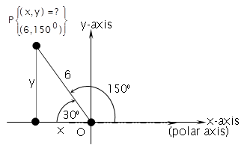
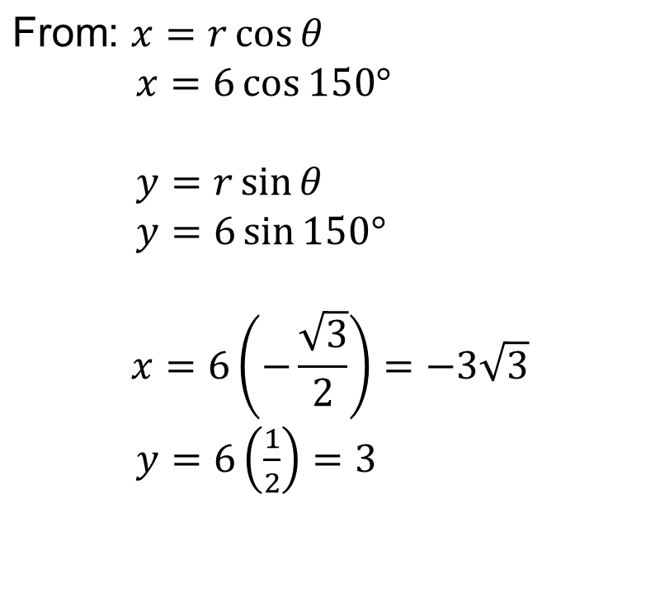

Slide 9
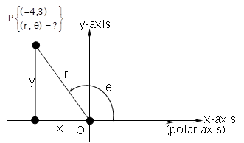
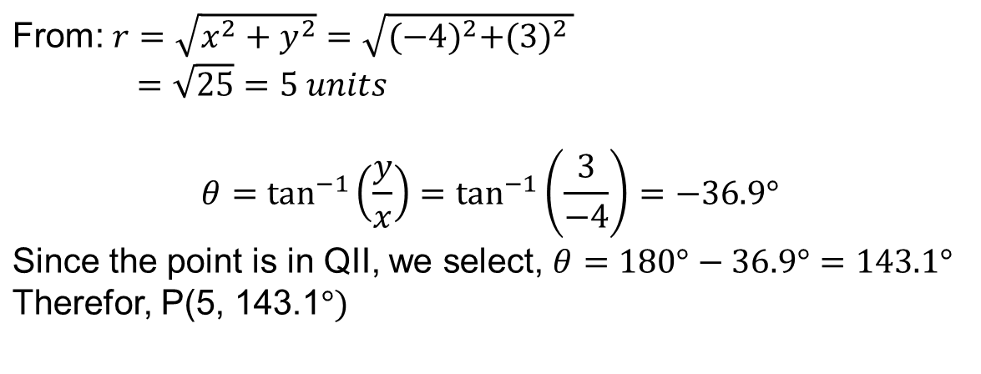
2. Express the rectangular coordinates (-4, 3) in terms of polar coordinates.

Slide 10
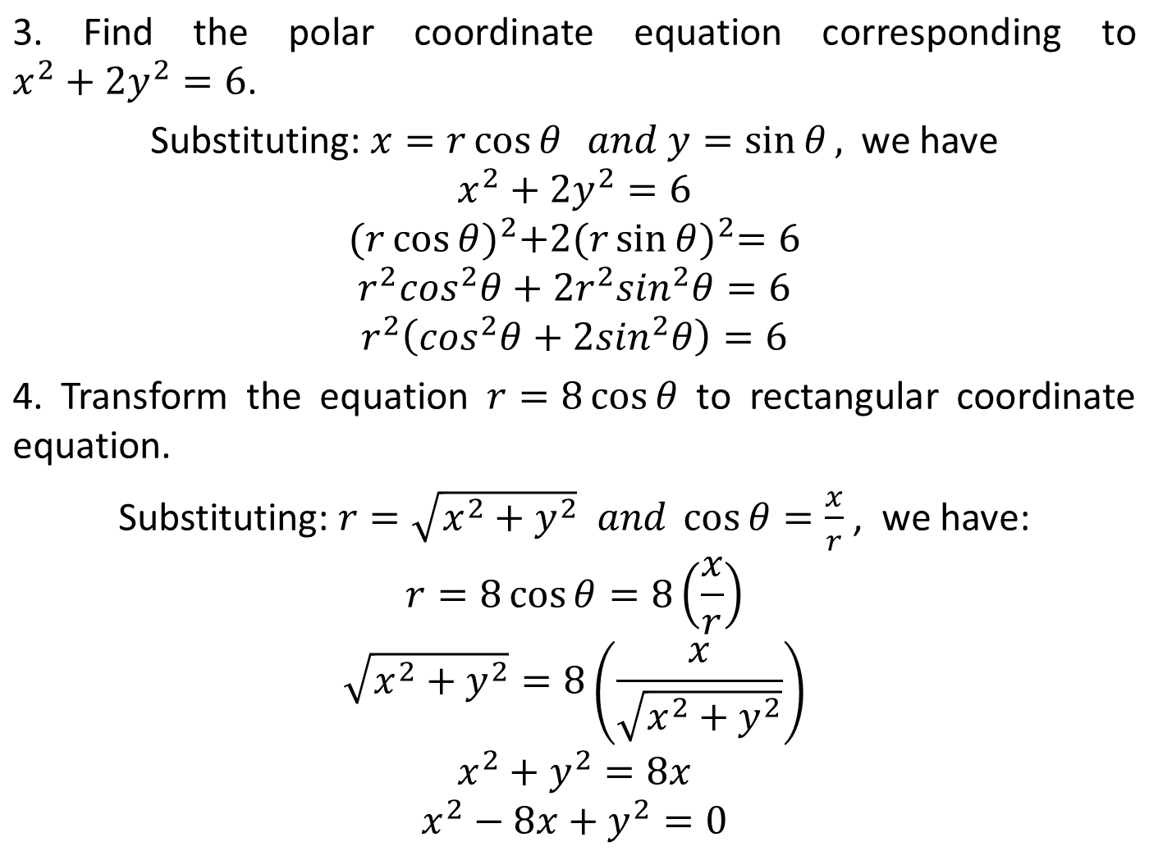

Slide 11
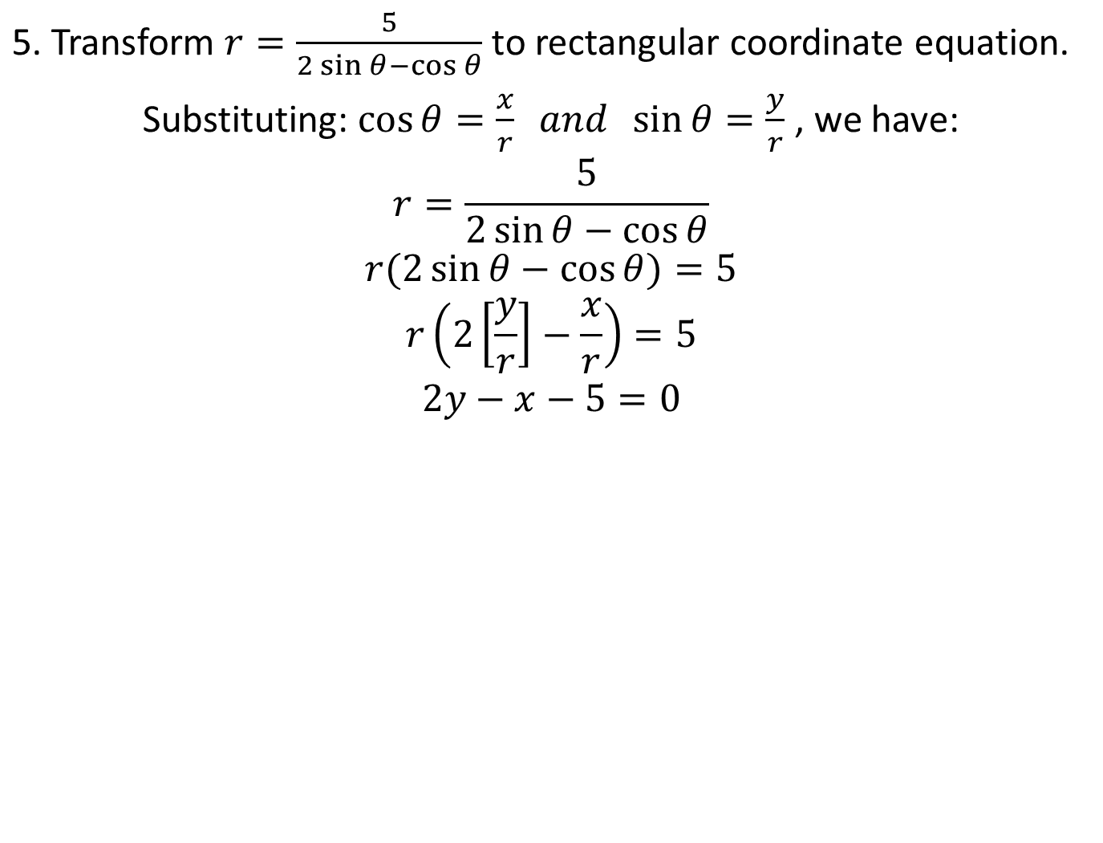



Slide 12
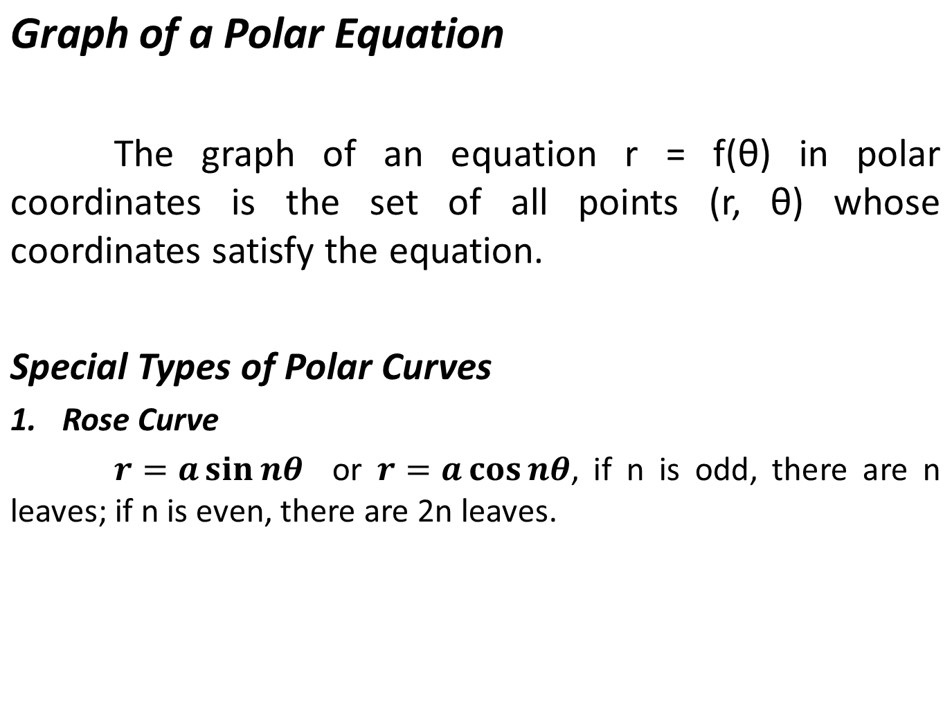

Slide 13
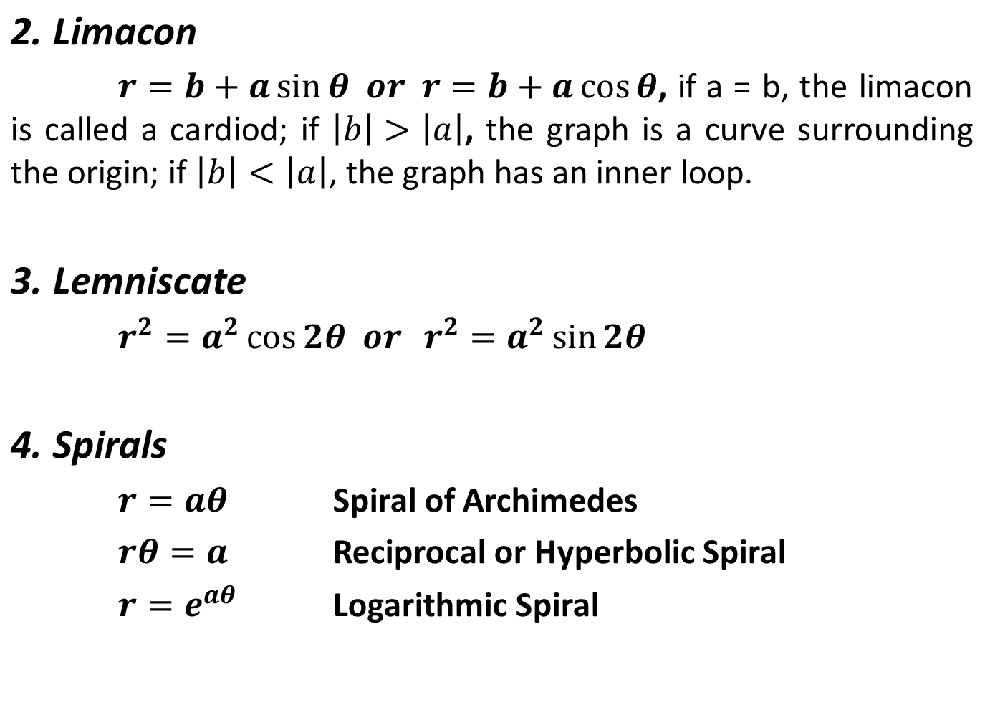

Slide 14
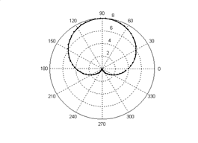
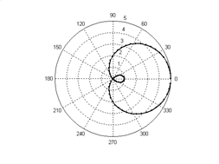
Cardiod
Limacon

Slide 15
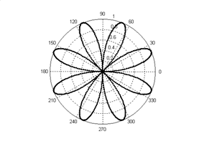
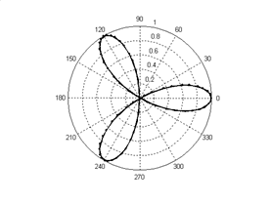
Eight – leaf Rose
Three – leaf Rose

Slide 16
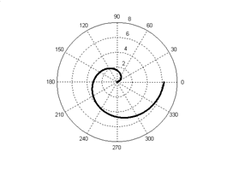
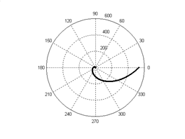
Spiral of Archimedes
Logarithmic Spiral

Slide 17
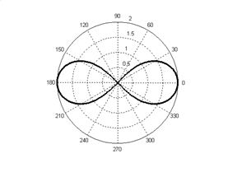
Lemniscate

Slide 18
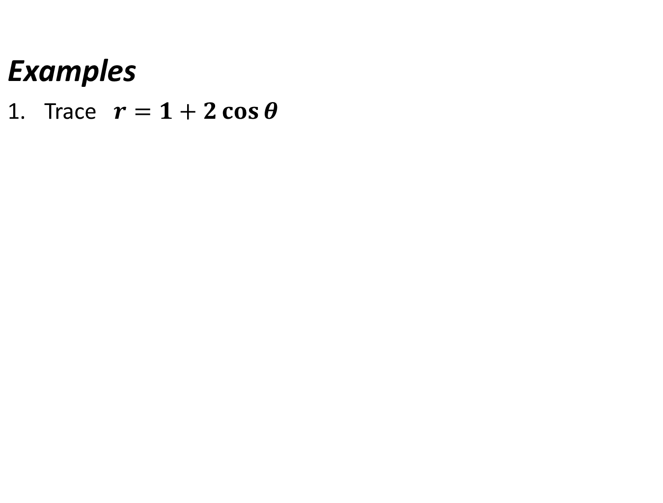


Slide 19
